Slide 1
MIGRATION OF SERVICES
By:
20PW17 - Karthikeyan
20PW18 - Kishor KR
20PW19 - Maanasa S
20PW20 - Mathiyazhagan S
20PW21 - Medam Sai Pranathi

Slide 2
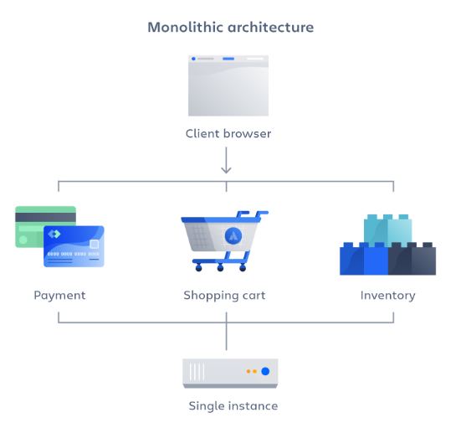
Monolith
A monolithic architecture is a traditional model of a software program,
which is built as a unified unit that is self-contained and independent
from other applications.
A monolithic architecture is a singular, large computing network with
one code base that couples all of the business concerns together.
To make a change to this sort of application requires updating the
entire stack by accessing the code base and building and deploying
an updated version of the service-side interface.
Monoliths can be convenient early on in a project's life for ease of
code management, cognitive overhead, and deployment.

Slide 3
Advantages
Organizations can benefit from either a monolithic or microservices architecture, depending on a number of different factors. When developing using a monolithic architecture, the primary advantage is fast development speed due to the simplicity of having an application based on one code base.
The advantages of a monolithic architecture include:
Easy deployment – One executable file or directory makes deployment easier.
Development – When an application is built with one code base, it is easier to develop.
Performance – In a centralized code base and repository, one API can often perform the same function that numerous APIs perform with microservices.
Simplified testing – Since a monolithic application is a single, centralized unit, end-to-end testing can be performed faster than with a distributed application.
Easy debugging – With all code located in one place, it’s easier to follow a request and find an issue.

Slide 4
Disadvantages
As with the case of Netflix, monolithic applications can be quite effective until they grow too large and scaling becomes a challenge. Making a small change in a single function requires compiling and testing the entire platform, which goes against the agile approach today’s developers favor.
Slower development speed – A large, monolithic application makes development more complex and slower.
Scalability – You can’t scale individual components.
Reliability – If there’s an error in any module, it could affect the entire application’s availability.
Barrier to technology adoption – Any changes in the framework or language affects the entire application, making changes often expensive and time-consuming.
Deployment – A small change to a monolithic application requires the redeployment of the entire monolith.

Slide 5
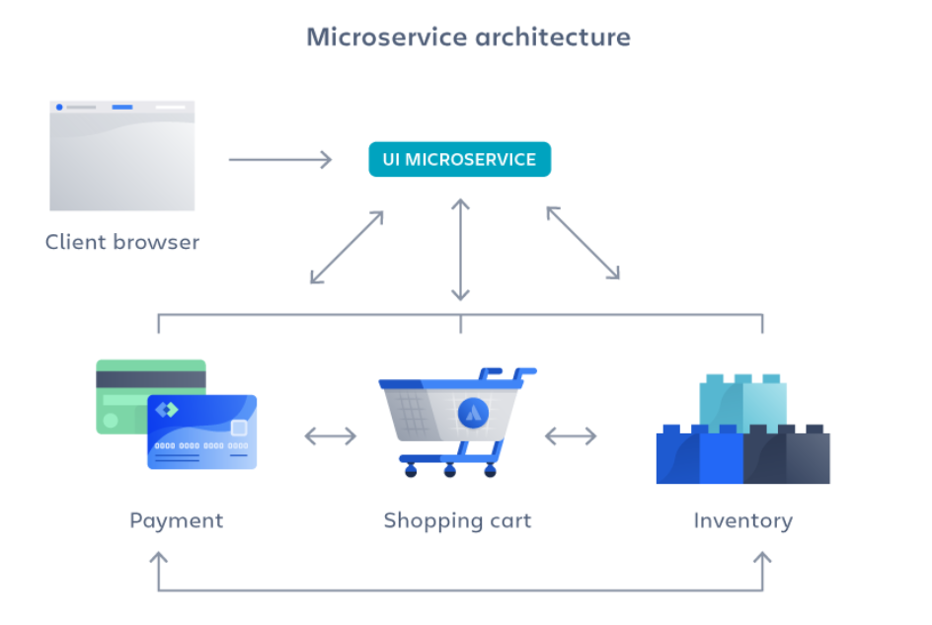
Microservices
A microservices architecture, also simply known as microservices, is an architectural method that relies on a series of independently deployable services.
These services have their own business logic and database with a specific goal. Updating, testing, deployment, and scaling occur within each service.
Microservices don’t reduce complexity, but they make any complexity visible and more manageable by separating tasks into smaller processes that function independently of each other and contribute to the overall whole.

Slide 6
Advantages
Since a microservices architecture consists of units that run independently, each service can be developed, updated, deployed, and scaled without affecting the other services. Software updates can be performed more frequently, with improved reliability, uptime, and performance
Flexible scaling – If a microservice reaches its load capacity, new instances of that service can rapidly be deployed to the accompanying cluster to help relieve pressure.
Continuous deployment – We now have frequent and faster release cycles. Before we would push out updates once a week and now we can do so about two to three times a day.
Highly maintainable and testable – Teams can experiment with new features and roll back if something doesn’t work. This makes it easier to update code and accelerates time-to-market for new features. Plus, it is easy to isolate and fix faults and bugs in individual services.

Slide 7
Independently deployable – Since microservices are individual units they allow for fast and easy independent deployment of individual features.
Technology flexibility – Microservice architectures allow teams the freedom to select the tools they desire.
High reliability – You can deploy changes for a specific service, without the threat of bringing down the entire application.

Slide 8
Disadvantages
Development sprawl – Microservices add more complexity compared to a monolith architecture, since there are more services in more places created by multiple teams. If development sprawl isn’t properly managed, it results in slower development speed and poor operational performance.
Exponential infrastructure costs – Each new microservice can have its own cost for test suite, deployment playbooks, hosting infrastructure, monitoring tools, and more.
Added organizational overhead – Teams need to add another level of communication and collaboration to coordinate updates and interfaces.
Lack of clear ownership – As more services are introduced, so are the number of teams running those services. Over time it becomes difficult to know the available services a team can leverage and who to contact for support.

Slide 9
Do we need to Switch from Monolith to Microservices
🎂 -> 🍰🍰🍰

Slide 10

Step 1: Identify the Logical Component
There are three major components with the data used in the system:
Data objects - logical construct of the data that is being used in the system is data objects
Data actions are the commands used on one or more data objects
Job to perform and use cases is the function called to perform a task on the available data.

Slide 11
Step 2: Flatten or Refractor Components
Once all the modules and components are uniquely identified and categorized, the businesses must organize these groups internally.
The components that have similar functionalities must be addressed before the implementation of microservice architecture.
In the end, there must be one microservice to perform a particular task.

Slide 12
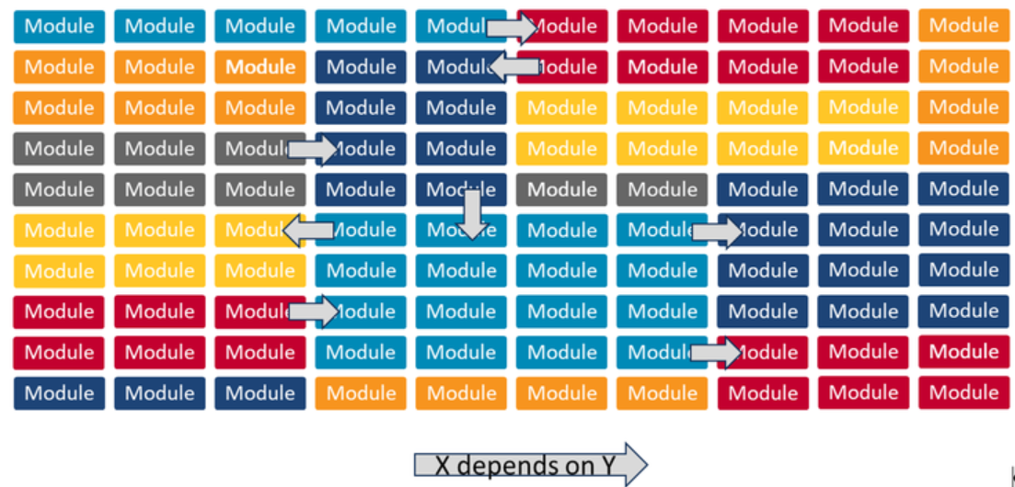
Step 3: Identify the Dependencies of the Components
After identifying and reorganizing the components for migrating from a monolithic application to microservices, the system architects must identify the dependencies between the components.
Architects can perform this task using static analysis of the source code to search for calls between different libraries and datatypes.

Slide 13
Step 4: Components Group Identification
After the components and dependencies are identified, the architects must focus on grouping the components into cohesive groups that can transform into microservices or at least microservices.
This step aims to identify a small set of objects and their constituent actions that should be logically separated in the final system.

Slide 14
Step 5: APIs for Remote User Interface
The remote user interface is the only mode of communication among the system, its components, and the system’s users and it must be scalable to adopt new features and technologies as the system evolves over the period.
The components are likely to change as they are worked upon, the remote user interface must manipulate the data when it is migrated from monolithic to microservices on AWS.
This step aims to develop a unified API through which the user interfaces with the system and manipulates the data.
Once the API layer is in place, all new functionality should be added through the API, not through the legacy applications.

Slide 15
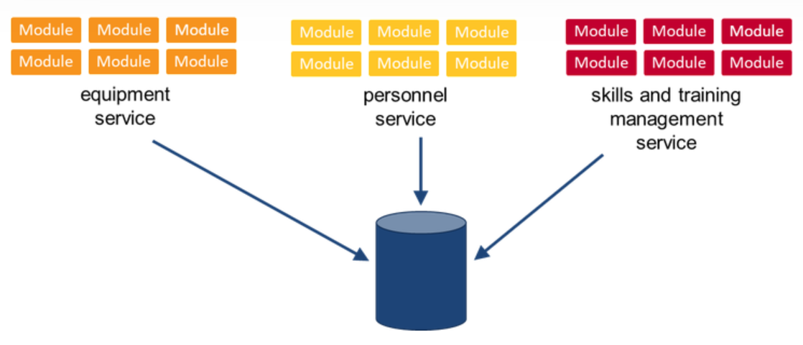
Step 6: Migrate the Components to Macroservice
The goal of this step is to move the components to separate projects and create separate deployments.
At a minimum, each microservice should be independently deployable from within the system’s continuous integration (CI) and continuous deployment (CD) pipeline.

Slide 16
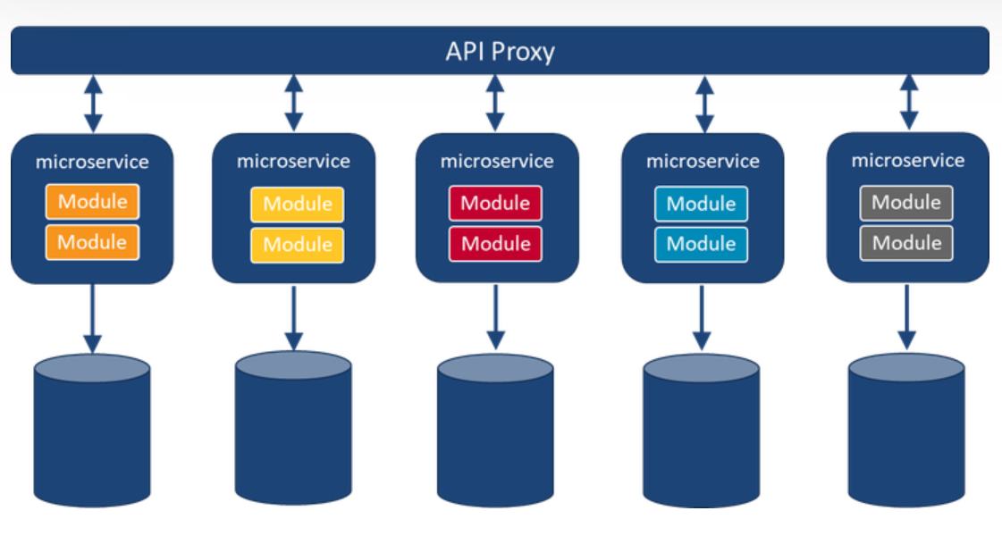
Step 7: Migrate Macroservice to Microservice
Once the components are migrated to macroservice, grouped and organized, the system architects must migrate these components of a monolithic application to microservice from macroservice.
Using macroservice as an interim process makes the migration easy and swift as it provides insight into how can further separate these components into microservices.

Slide 17
Step 8: Deployment and Testing
The monolithic system must be configured to use the new service for its data needs instead of its legacy data store.
In a testing environment, it might be possible to remove the legacy data related to the migrated datasets for which the new microservice is now responsible.

Slide 18
Microservices
Communication Patterns

Slide 19
There are 3 types
Synchronous
Real Time communication
Asynchronous
Communication independent of time
Hybrid
Supports both

Slide 20
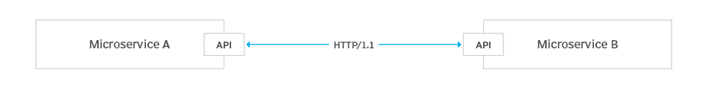
Synchronous Communication
Moves to and from an endpoint in a blocking interaction.
Ex: HTTP request/ response interaction.
Notes:
When a request is made to an endpoint under HTTP, the caller is locked in the interaction until a response is received. The caller might receive the response in a mere millisecond or in a few seconds. Ex: REST

Slide 21
Synchronous One to One Communication
Synchronous communication is mostly one to one.
This type of communication is maintained even when multiple instances of a service are used.
Ex. Netflix
Notes:
we have multiple instances of a particular service, but the services are still communicating one-to-one. That means that each service communicates to an instance of another service. The load balancer chooses which method should be called.

Slide 22
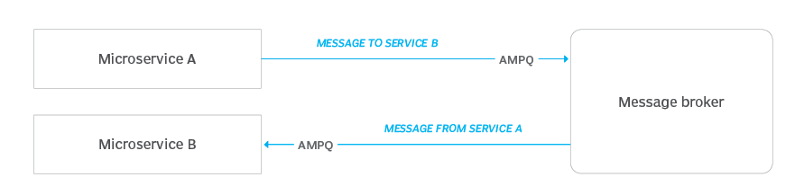
Asynchronous Communication
Request and its response occur independently from each other.
Ex: HTTP request/ response interaction.
Notes:
Called as a message broker technology. Ex: Kafka. The intended service receives the message in its own time. The sending service is not locked to the broker. It simply fires and forgets.

Slide 23
Asynchronous One to One Communication
Each request addressed by one instance of a service.
Notification: Client sends a request for Service but doesn’t wait for the reply.
Async Response: Client waits but does not block the request thread.

Slide 24
Asynchronous One to Many Communication
Each request addressed by multiple service instances.
Publish/ Subscribe: Client makes request to the message broker and some or no service addresses it.
Async Response: Client waits for a certain amount of time.

Slide 25
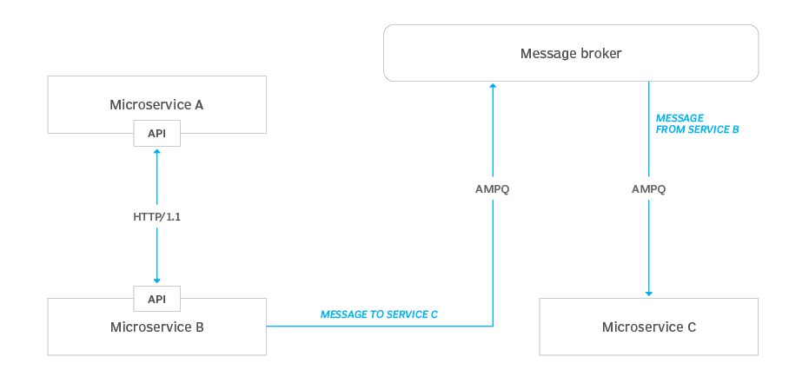
Hybrid Communication
Asynchronous + Synchronous.
Ex: HTTP + messaging protocols.
Notes:
Microservice B accepts an HTTP request from Microservice A. But, before Microservice B responds to Microservice A, it sends a message to Microservice C. The message sent to Microservice C mostly likely will contain information that is relevant to the concern of Microservice C. Microservice B sends the message to Microservice C asynchronously, without having to wait for a response from Microservice C. This hybrid pattern has a definite advantage for those concerned with the speed of interactions.
Ex: GraphQL

Slide 26
Pros and Cons
Synchronous:
Easy to implement.
What if Service 2 needs very long to process the Service 1’s request and Service 1 is tired of waiting? Service 1 will then probably have some sort of timeout exception and roll back the current transaction. However, Service 2 doesn’t know that Service 1 rolled back the transaction and might process the request after all, perhaps resulting in inconsistent data between the two services.
Synchronous communication creates a strong coupling between the services. Service 1 cannot work without Service 2 being available. To mitigate this, we have to work around communication failures by implementing retry and / or fallback mechanisms.

Slide 27
Pros and Cons
Asynchronous:
If Service 2 is currently not available, the message broker will try to deliver the message again until Service 2 finally gets it.
Messaging makes the services loosely coupled since Service 2 doesn’t need to be available at the time Service 1 sends the message.
If message broker fails, all service ceases functioning.
Notes:
Instead of sending a message directly to the message broker, we now store it in the service’s database first. Same on the receiving side: here the message gets stored into the receiver service’s database before it is being processed. We can just send the messages again from our message database table when message broker fails.

Slide 28
When to use what?
Synchronous Calls if:
Simple querying of data
Message failing is allowed and retry mechanism is not required
Asynchronous if:
Message failing is not allowed
Queries can be simple or complex

Slide 29


Slide 30
Reason for this Migration
When Netflix announced its big move to the cloud they faced a lot of criticism as no one believed such a feat was possible at that time. The main reason why Netflix had decided to move to the cloud was due to its rapidly increasing data and user information that it was hard to store it in its current data centers, this caused a huge deal of problems. The solution was accomplished using Amazon Web Service (AWS), which promised to provide large computing resources and data centers with guaranteed security and reliability. With AWS scaling can be done within a couple of minutes without any user involvement.

Slide 31
How to make microservice architecture reliable?
Hystrix
In a complex distributed system a server may rely on the response of another server. Dependencies among these servers can create latency and the entire system may stop working if one of the servers will inevitably fails at some point. To solve this problem we can isolate the host application from these external failures. Hystrix library is designed to do this job. It helps you to control the interactions between these distributed services by adding latency tolerance and fault tolerance logic.
Separate Critical Microservices
We can separate out some critical services (or endpoint or APIs) and make it less dependent or independent of other services. You can also make some critical services dependent only on other reliable services.

Slide 32
How to make microservice architecture reliable?
Treat Servers as Stateless
The idea is to design the service in such a way that if one of the endpoints is giving the error or if it’s not serving the request in a timely fashion then you can switch to another server and get your work done. Instead of relying on a specific server and preserving the state in that server, you can route the request to another service instance and you can automatically spin up a new node to replace it. If a server stops working, it will be replaced by another one.

Slide 33
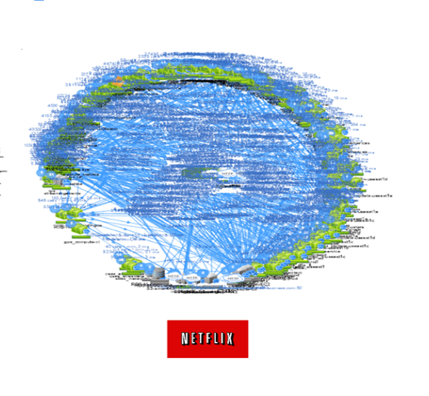
Netflix Architecture

Slide 34
ZUUL
Zuul is a software component that serves as a gateway and proxy for all incoming and outgoing traffic in Netflix's cloud-based architecture. It is responsible for routing requests from clients to the appropriate microservices within the Netflix ecosystem.
When a client sends a request to a Netflix service, the request first goes to Zuul. Zuul examines the request and determines which microservice is responsible for handling the request. It then forwards the request to the appropriate microservice.

Slide 35
ZUUL
Zuul also performs other functions such as load balancing, security, and filtering. For example, it can limit the rate of requests from specific clients to prevent abuse or it can apply authentication and authorization rules to ensure that only authorized clients can access certain services.
Zuul is highly customizable and can be configured to handle various use cases. For example, it can be used to provide routing and load balancing for microservices that are deployed across multiple data centers or regions.

Slide 36
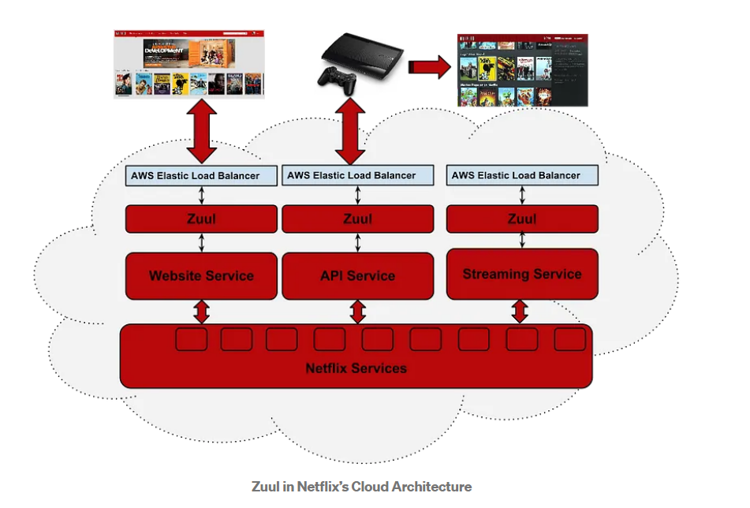

Slide 37
Key steps that Netflix took during their migration
Identifying services: Netflix began by identifying the different services within their monolithic application and breaking them down into individual components. This involved analyzing the dependencies between different parts of the application and determining which components could be separated into their own services.
Decentralizing data storage: Netflix moved away from a centralized database to a more distributed data storage architecture, where each microservice manages its own data. This allows for greater scalability and fault tolerance, as well as more efficient data management.

Slide 38
Key steps that Netflix took during their migration
Implementing API gateways: Netflix introduced API gateways as a way to manage the communication between different microservices. This provides a layer of abstraction between the services and allows for more efficient routing and load balancing.
Adopting DevOps practices: Netflix embraced DevOps practices, such as continuous integration and deployment, to help streamline their development and deployment processes. This allowed them to quickly deploy new features and updates to their services while maintaining high levels of quality and reliability.

Slide 39
Key steps that Netflix took during their migration
Using cloud infrastructure: Netflix migrated their infrastructure to the cloud, which allowed them to take advantage of the scalability and flexibility of cloud services such as Amazon Web Services (AWS). This also allowed them to easily spin up new instances of their microservices as needed.

Slide 40
Services replaced :
Database services: separating the database service from the rest of the application allows for more flexibility in choosing the type of database technology used, as well as easier maintenance and scaling.
Authentication and authorization services: decoupling these services from the main application can improve security and allow for more granular control over access to resources.
Payment processing services: separating payment processing services from the main application can provide greater security and compliance with payment processing regulations.

Slide 41
Services replaced :
Email and notification services: separating these services from the main application can improve scalability and performance, as well as provide greater flexibility in managing different types of communication.
CDN (Content Delivery Network) services: separating the CDN services from the main application can improve website performance, reduce load on the main server, and provide better geographical reach.

Slide 42
Issues faced during migration:
Service Identification
Data Management
Testing
Communication
Deployment
Scalability
Monitoring and Logging

Slide 43
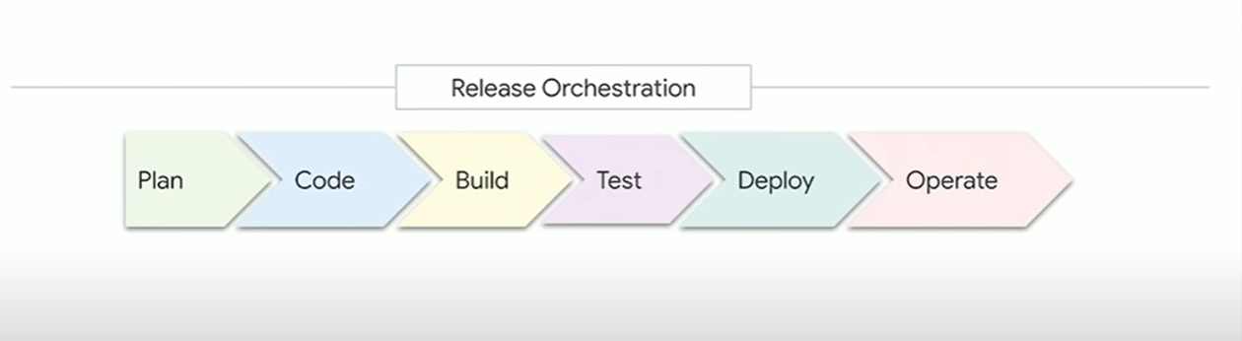
LOUHI

Slide 44
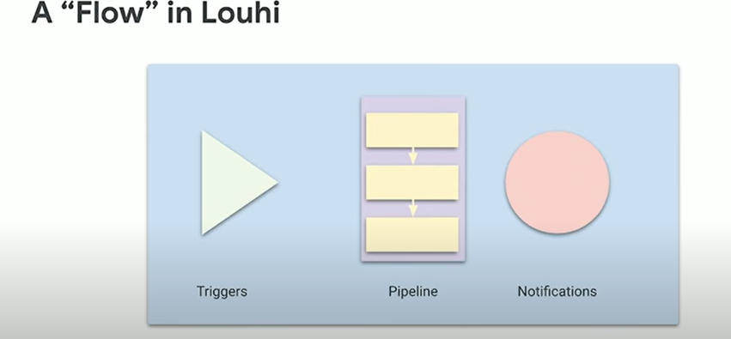
LOUHI

Slide 45
GLASSPANE
Glasspane on the other hand is an internal metrics platform at Google that's essentially designed to help leaders understand the health and relative performance of their projects and teams through mainly actionable insights.

Slide 46
WHY THEY WAS STARTED AS MONOLITH
Experiment and Study
Focus on Business logic
Prevents initial overdesign
Small teams can manage changes
O(1) debugging,security and operations

Slide 47
IT WAS GOOD WHILE IT LASTED
More product Requirements
Onboarding new team members
Too much cognitive load
Delaying Deployments to sync features
No independent scaling
Messy to debug

Slide 48
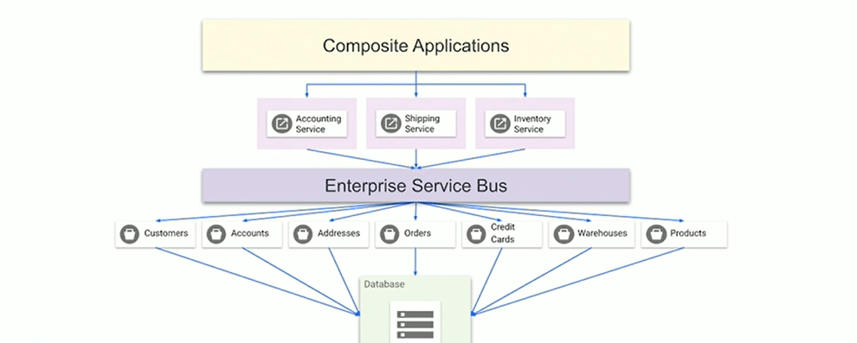
SERVICE ORIENTED ARCHITECTURE

Slide 49
BENEFITS OF MICROSERVICES
Easy onboarding process
Different tech stacks
Isolated Responsibility
Fault tolerant
Scalable and Deploy independently

Slide 50
QUESTIONS ASKED
How big the services would be?
How do I go about splitting them up?
SERVICE GRANULARITY:
No one size fits all
Depends upon infrastructure (overhead, creation than implementation, Domain driven design),SRL

Slide 51
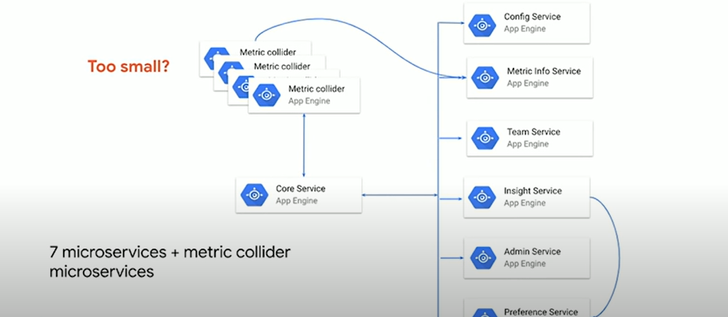
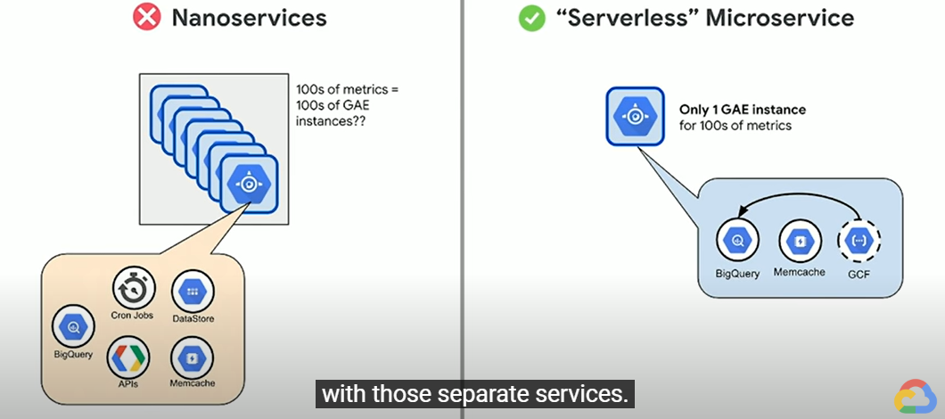
BEWARE OF ANTIPATTERNS!

Slide 52
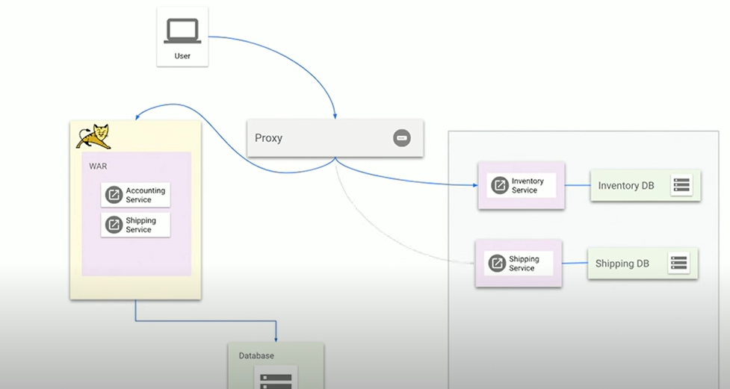
STRANGLER PATTERN

Slide 53
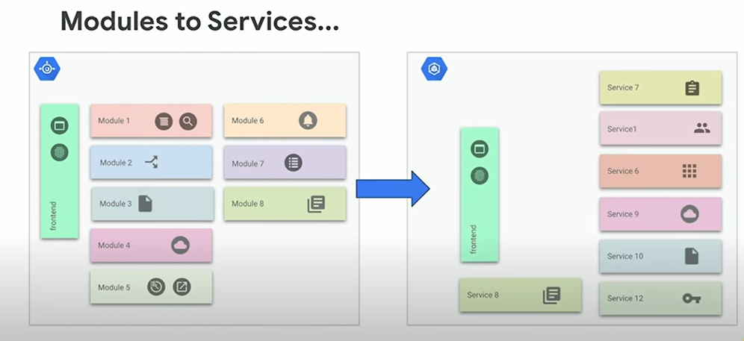
LOUHI

Slide 54
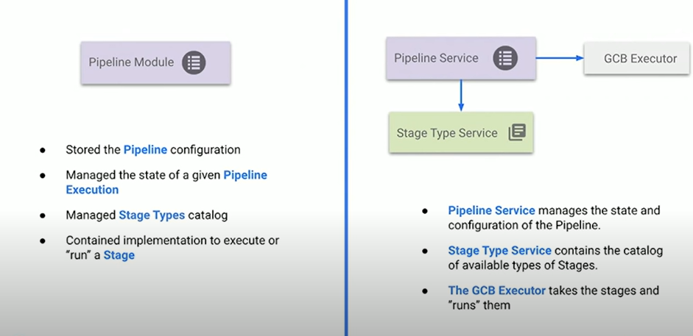
PIPELINE MODULE

Slide 55
WHERE TO START?
Design Docs
Create a Strategy (each service,Final architecture design)
Split up the repo?(Clear dependency relationships,Deploy sep.)
Set team responsibilities

Slide 56
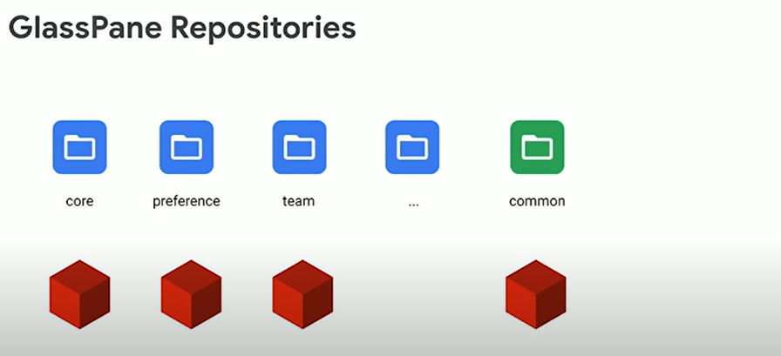
GLASSPANE

Slide 57
GOOGLE KUBERNETES ENGINE
Deploy a wide variety of applications
Self healing services capabilities
Autoscaling capabilities
Declarative Config
Easy Network Setup and upgrade roll outs
Integration with GCP services

Slide 58
BACKEND-SPRING
Familiarity with Java
Mature Framework
Open Source
Cloud-Native
Flexible and lots of Docs

Slide 59
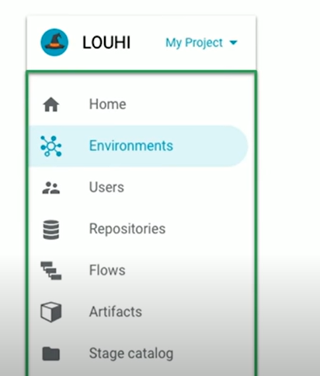
FRONT END - POLYMER

Slide 60
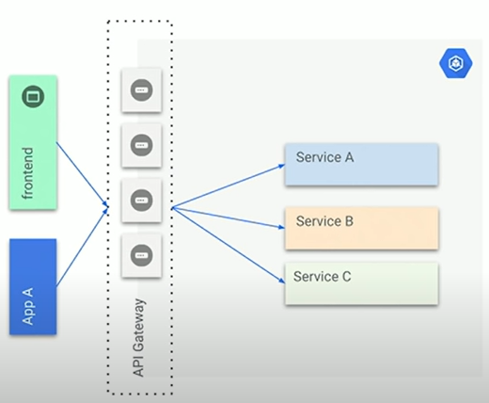
HOW DO I EXPOSE MY SERVICES?
Decoupling Clients from the downstream services
Provides the optimal API for each client
Aggregate calls to services
Throttling on requests.
Retry
Perimeter Security

Slide 61
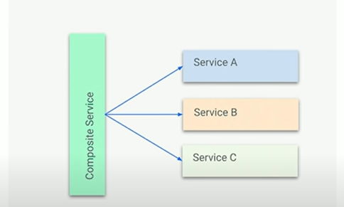
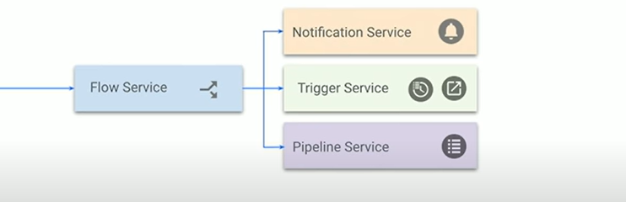
AGGREGATOR/COMPOSITE SERVICE
Some services can aggregate calls
To other services.This allows you to
Simplify the calls and implement
Additional logic

